Slide 1
Welcome
COM3024 & ECMM426: Computer Vision
Sareh Rowlands
Department of Computer Science
University of Exeter

Slide 2
Staff
Lecturer
  Dr Sareh Rowlands
    S.rowlands@exeter.ac.uk
Postgraduate Teaching Assistant
  Mahsa Mohammadi
    mm1510@exeter.ac.uk
  Ashish Sundar
    as1748@exeter.ac.uk
  Desong Zhang
    dz288@exeter.ac.uk

Slide 3
Topics
Image Processing
Image processing, Linear and Non-linear filtering
Feature Extraction (edges/corners/blobs/ridges..)
{Texture, Motion, Colour, Shading} Analysis
Deep Learning
Linear Classifiers, Optimisation
Neural Networks, Backpropagation
CNN, Recurrent Networks
Object Recognition, Detection
Semantic and Instance Segmentation
Videos and Action Recognition
Low-shot and Unsupervised Learning
3 weeks
4 weeks
3 weeks

Slide 4
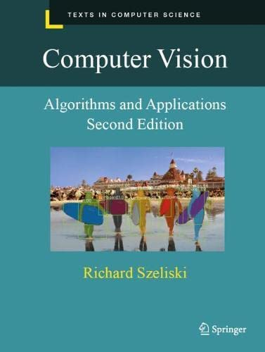
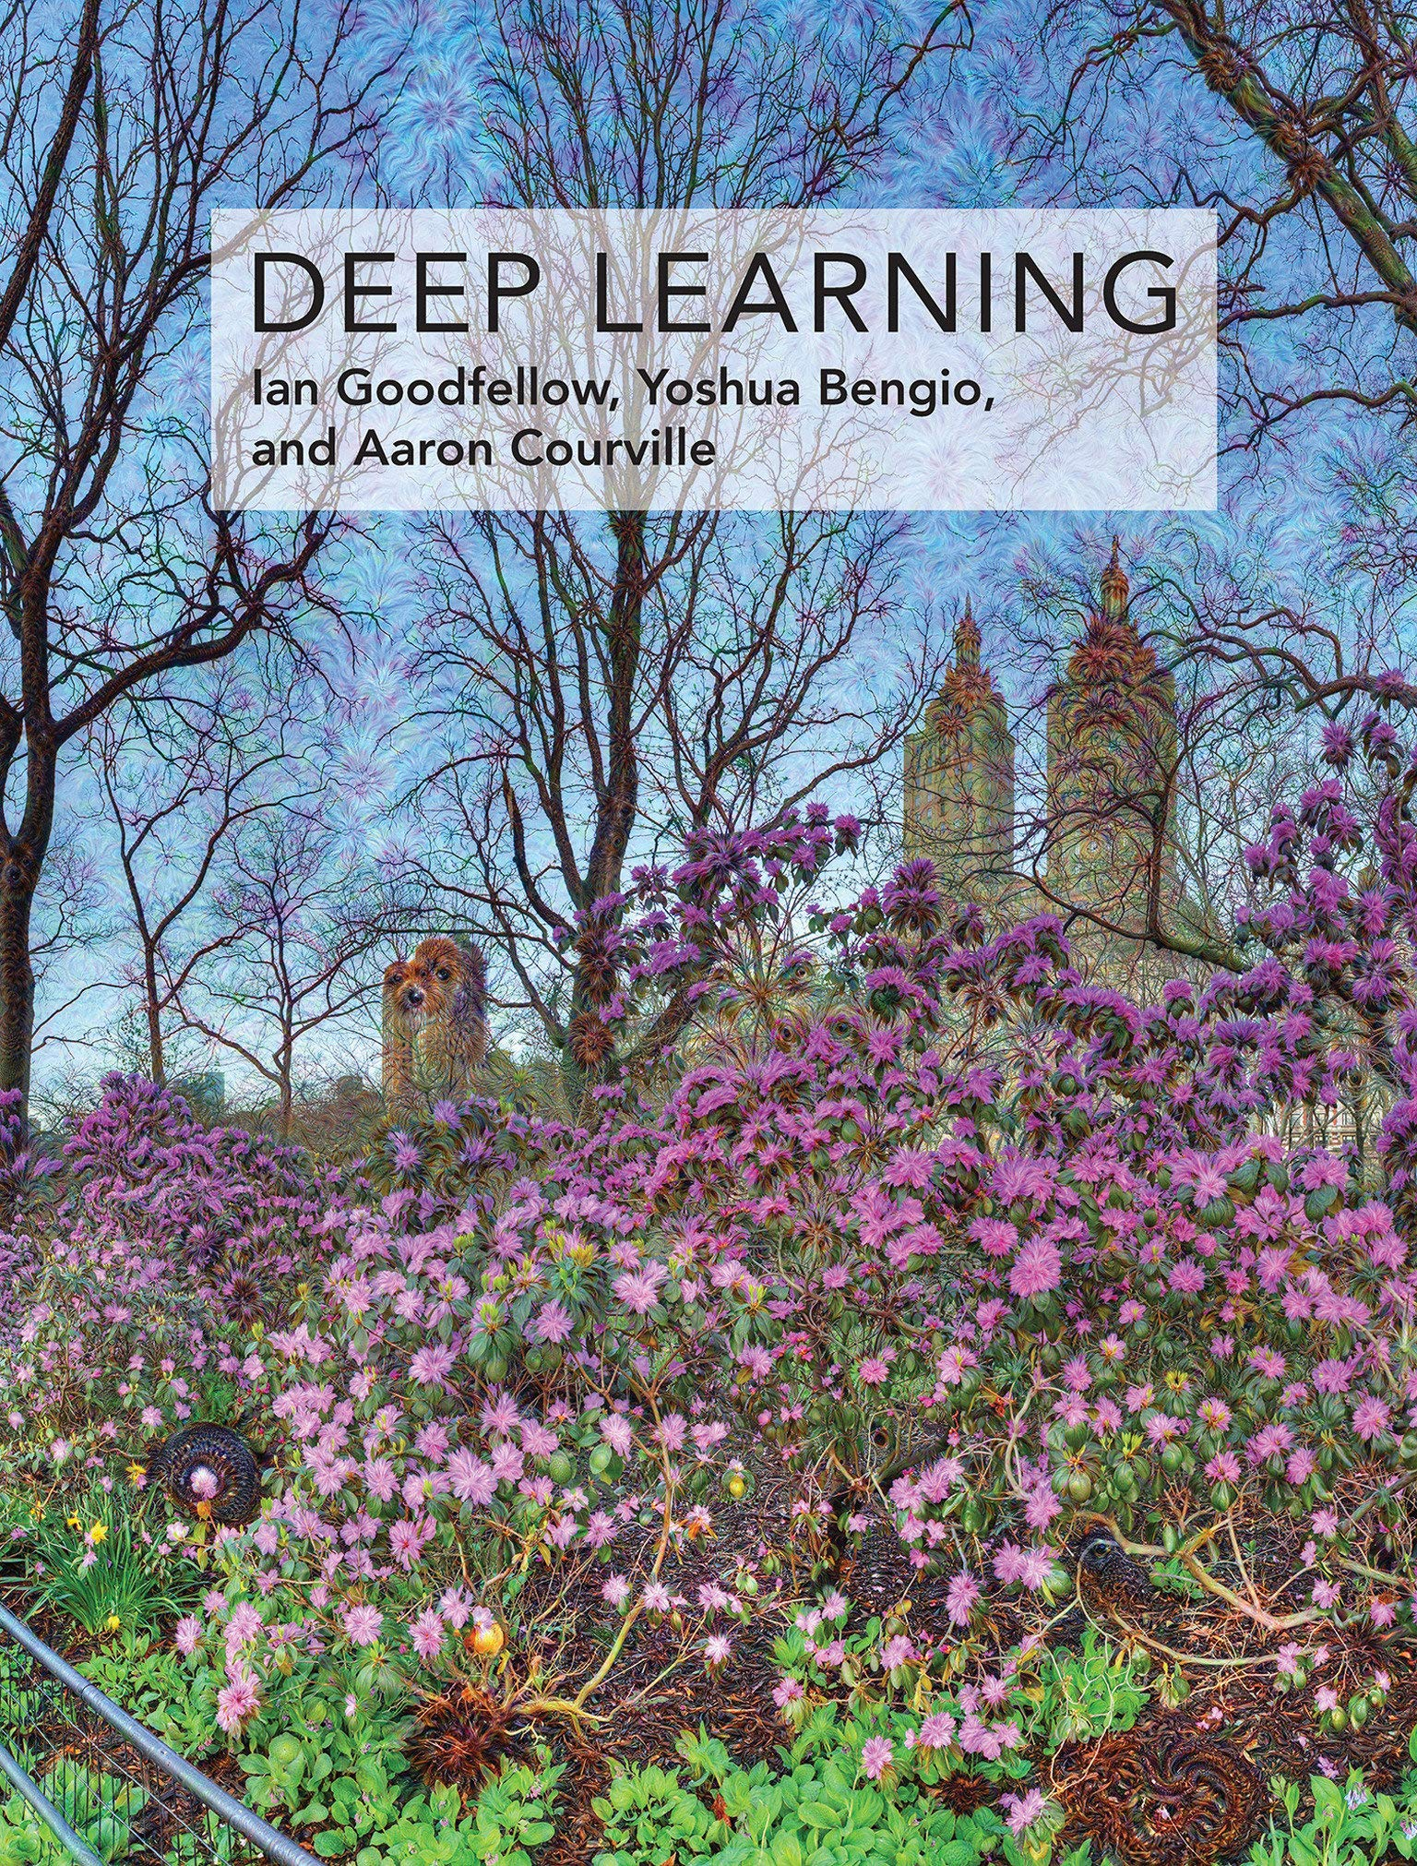
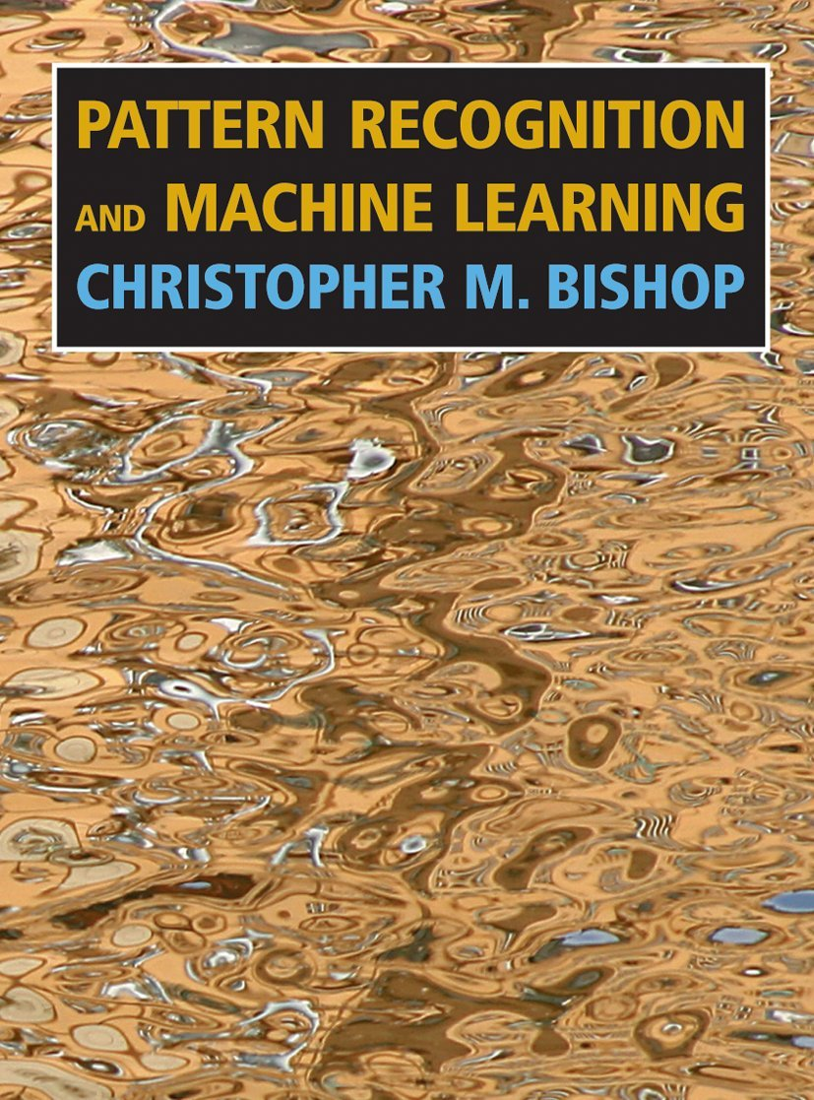
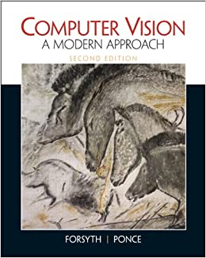
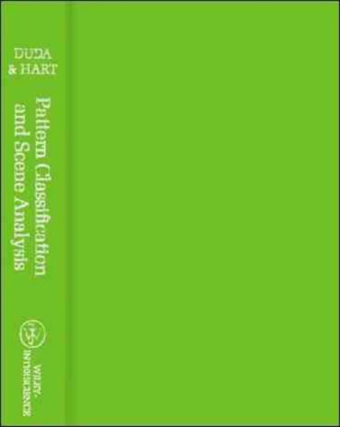
Books
Computer Vision: Algorithms and Applications (2nd Ed), R. Szeliski
Pattern Recognition and Machine Learning, C. M. Bishop
Deep Learning, I. Goodfellow, Y. Bengio and A. Courville
Computer Vision: A Modern Approach, D. Forsyth and J. Ponce
Pattern Classification and Scene Analysis, R.O. Duda, P.E. Hart and D.G. Stork

Slide 5
Organisation
Lectures
  Monday at 14:35h at Parker Moot Room LT /Amory
  Friday at 11:35h at LT A/Streatham Court
Workshop
  Tuesday 09:35h at Lovelace/Innovation Centre 2 (ECMM426)
  Tuesday 10:35h at Lovelace/Innovation Centre 2 (COM3024)

Slide 6
Workshops on Google Colab
Workshops
  Jupyter Notebooks
    Download the .ipynb file from ELE
    Upload it to your Google drive
    Open it with Google Colab
  Programming Exercises
    Download from ELE
    Formative assessment
    Oral feedback
    No model answers

Slide 7
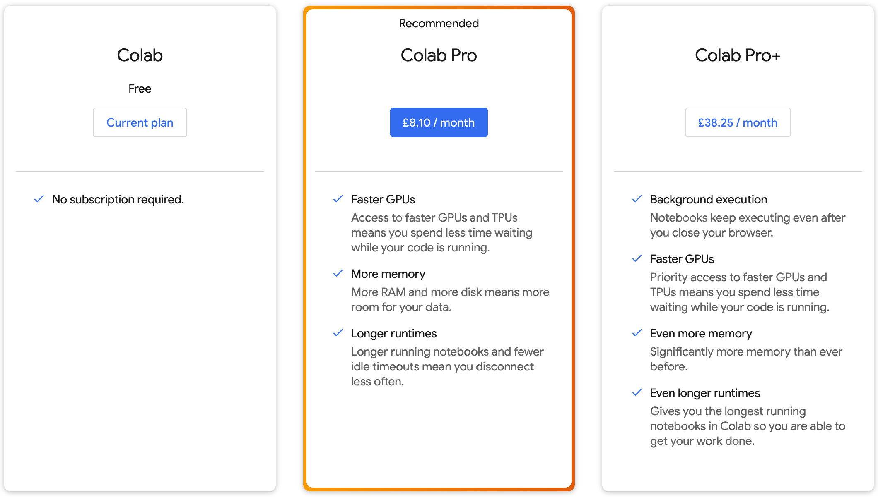
Google Colab

Slide 8
Assessments
Quiz (30% weightage)
  Questions from lectures material
  Number of questions: TBC
  Duration: TBC
  Date: TBC
Coursework (70% weightage)
  Programming exercises covered during the workshops
  Availability: Now
  Deadline: 4 March 2026 (COM3024) & 25 February 2026 (ECMM426)

Slide 9
Questions?

